Slide 1
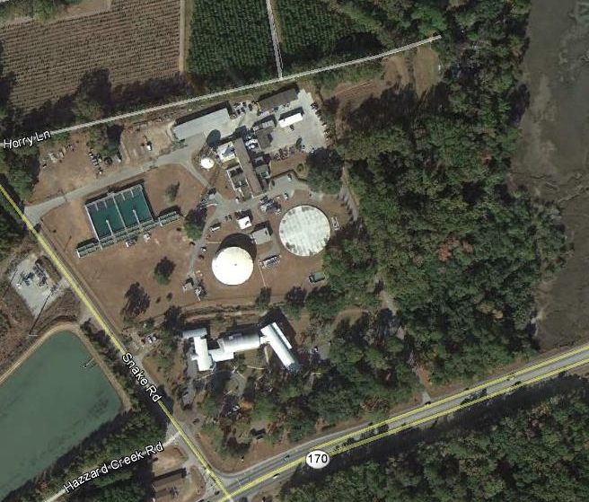
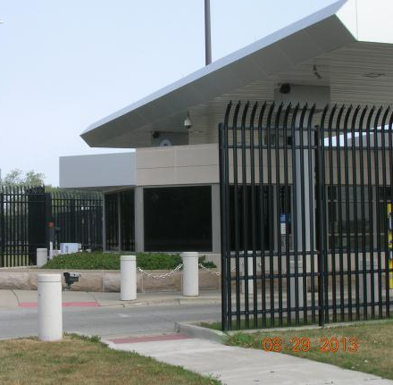
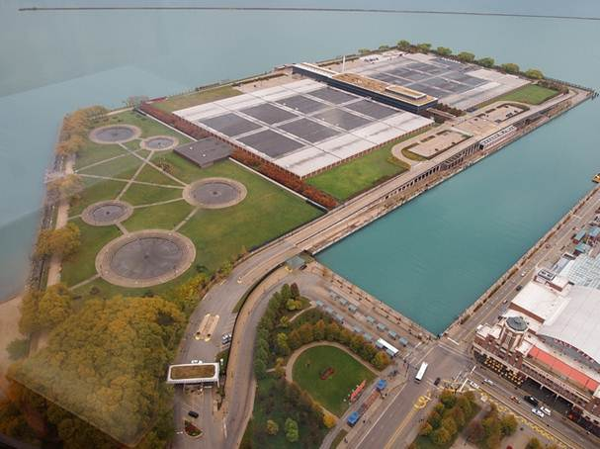

J100 on a Budget: Maximizing the Benefits Derived from a J100 RAMCAP Risk Assessment while Managing Costs
Perry Gayle, PhD, PE, LEED AP

Slide 2
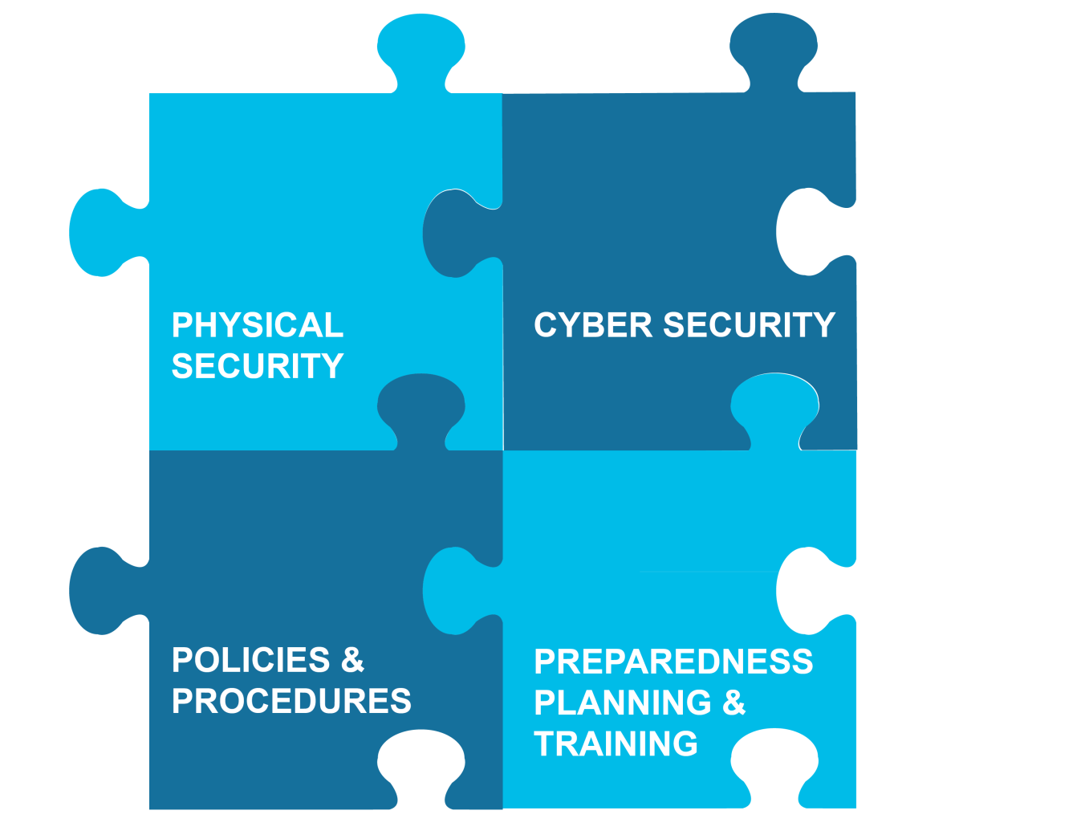
Presentation Overview
Vulnerability assessment (VA) industry trends
Benefits of J100 RAMCAP
Strategies to maximize benefits
Balancing level of effort to cost-effectively achieve goals

Slide 3
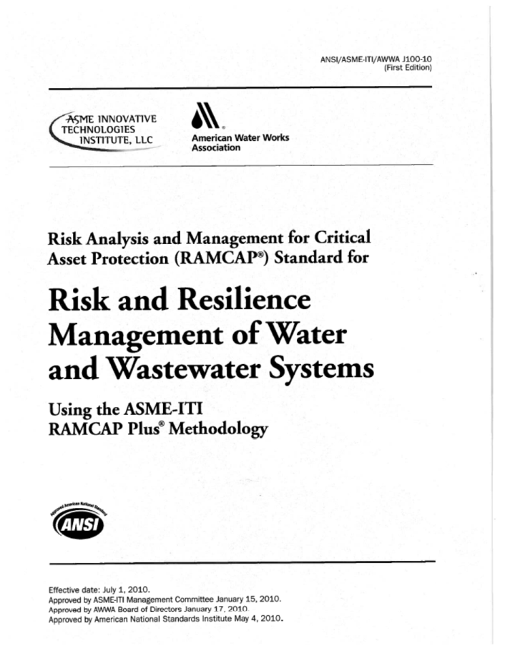
Positive Industry Trends
Proactive utilities are updating previous VAs
Many often include wastewater assets
Commonly using an all-hazards approach
Recognition that threats are evolving
Replacement of “end-of-life” security systems
Use of improved assessment tools such as J100

Slide 4

Unfortunate Industry Trends
Shrinking budgets
Pressure to do more with less
Staff turnover
Loss of institutional knowledge
New processes and systems
Change management challenges

Slide 5

Cost / Benefit Considerations
It is more important than ever to:
Be efficient
Make smart decisions
Get what you pay for
Achieve return on investment
Utilities need to maximize the benefits while managing costs
Cost
Benefits

Slide 6
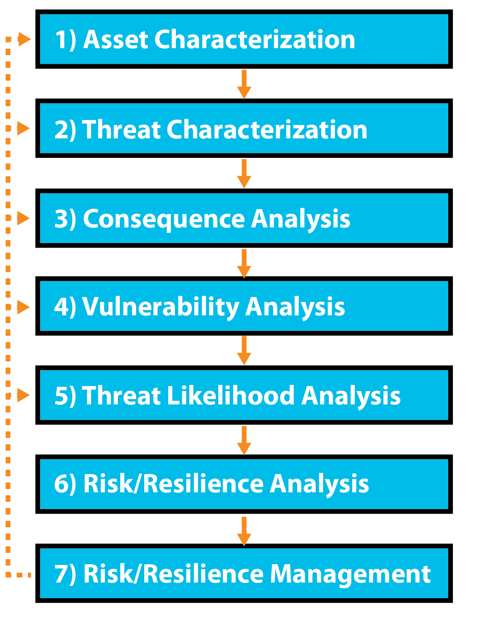
Benefits of J100 RAMCAP
Prioritizes risks
Quantifies potential consequences
Supports long-term planning
Justifies investments
Promotes return on investment
Builds a foundation for continuous improvement
Protects the public and decision makers

Slide 7
Strategies to Maximize Benefits
Do not simply cut corners
Be careful not to make changes that alter the outcome
Do not take shortcuts with the most important steps
Understand the importance of preliminary planning
Recognize that consensus-building workshops are essential for success
Recognize the most labor-intensive steps
Understand the range of uncertainty within the risk calculations
Minimize unnecessary “heavy lifting”

Slide 8
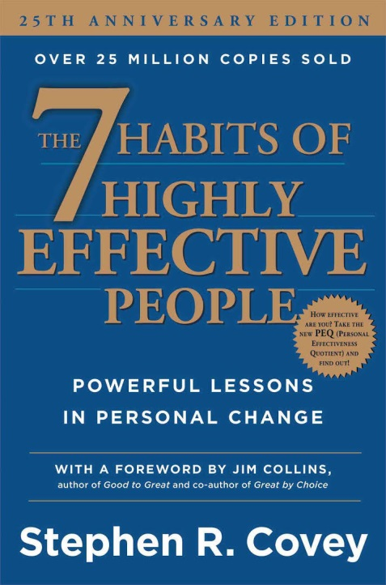
Begin with the End in Mind
This is a widely used concept
Stephen Covey’s 7 Habits of Highly Effective People
Also used in education to develop learning objectives
Also used in manufacturing product development
Work backwards to solve complex problems
Understand what result or outcome is expected
Determine what is necessary to get there

Slide 9
Begin with the End in Mind
First, understand the desired result and then craft the scope of work (SOW)
The requirements in the SOW impact the cost and the product / outcome
At a minimum, seek input from industry experts in developing the SOW
The ideal scenario would be to conduct a facilitated workshop with stakeholders
Define the desired result up front
Ensure stakeholder consensus
Work backwards to develop the SOW necessary to accomplish the desired result

Slide 10
Consider J100 Reference Threats
Natural hazards
Hurricanes, earthquakes, tornadoes, floods
Dependency and proximity hazards
Utilities, suppliers, employees, customers, transportation
Proximity
Malevolent threats
Additional custom threats as appropriate
Contamination
Process sabotage
Diversion or theft
Maritime (M1 – M4)
Air (A1 – A4)
Land (V1 – V4)
Assault teams (AT1 – AT4)

Slide 11
Select Realistic Threats
Do not select reference threats that you cannot feasibly mitigate
 | AT1 Threat Capability (1 assailant) | AT2 Threat Capability (2-4 assailants)
Weapons | Pistol, assault rifle, light machine gun | Pistols, assault and sniper rifles, light machine guns
Explosives | Grenades, explosive vest or satchel, plus 65 lbs | Grenades, bulk explosives, 400-lb TNT VBIED, plus 65 lbs per person
Tools | Minimal breaching tools | Mechanical breaching tools, required hand tools
Delivery system – Land | Pedestrian, ATV, motorcycle, personnel transport, cargo truck | ATVs, motorcycles, personnel transport, cargo truck
Delivery system – Water | Lone swimmer | Small boat, swimmers
Delivery system – Air | N/A | Helicopter

Slide 12
Select Realistic Threats
Consider in advance the response measures necessary to mitigate the threat
Will it be financially, socially, and politically acceptable to implement these measures
Use workshops to reach a consensus on investments the utility is willing to make versus risk the utility is willing to accept
Considering unrealistic threats adds level of effort and cost

Slide 13
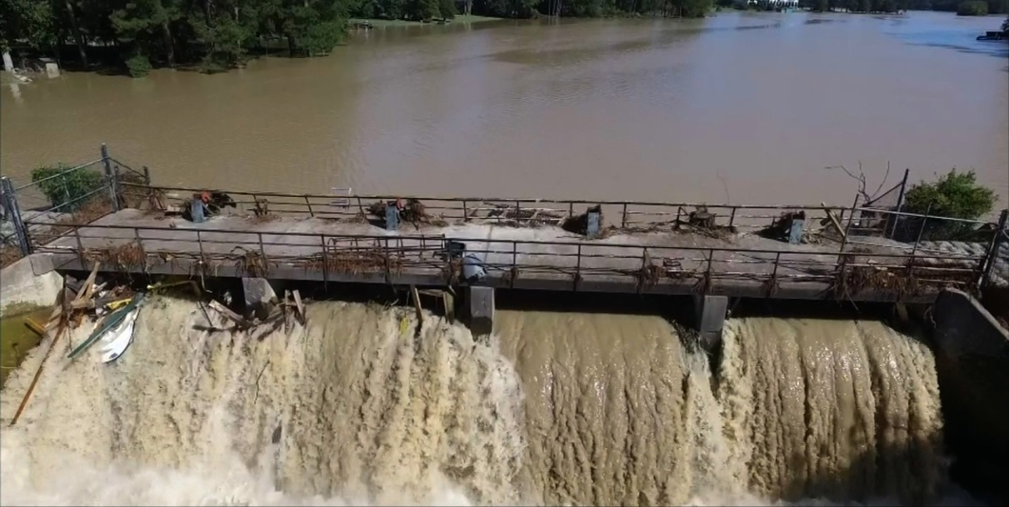
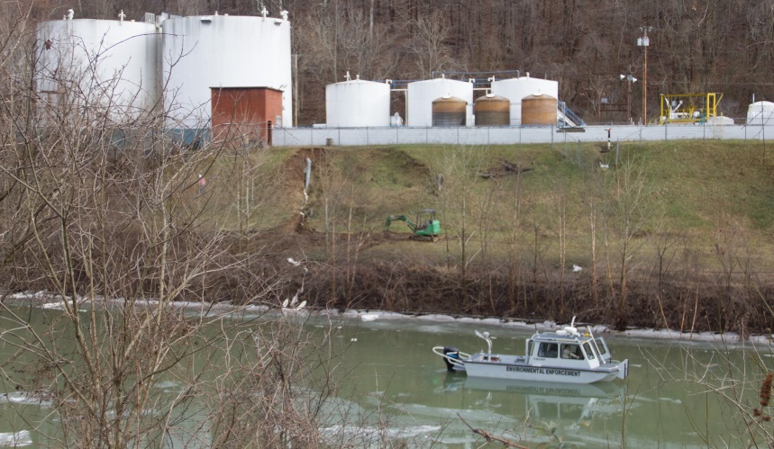
Consider Custom Threats
Maximize benefits by selecting custom threats that make sense for the specific utility
Assault team “AT1.5”
Sophisticated, multi-vector cyber
Custom threats developed from lessons learned
Active shooter

Slide 14

Consider Custom Threats
Consider an active shooter custom threat
There have been 72 public mass shootings since 1982
Water utilities are not immune to this threat
Perpetrators often exhibit warning signs
Awareness training can reduce risk
Improve likelihood of detection
Teach appropriate response procedures
Reduce consequences of event

Slide 15
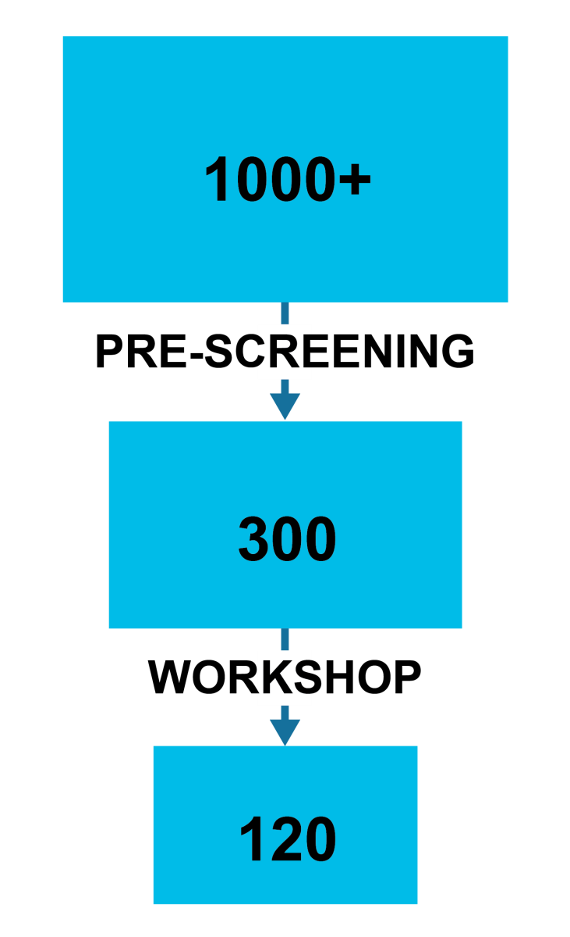
Consolidation of T-A Pairs
The number of T-A pairs impacts the level of effort and cost of assessment
J100 recommends prioritization techniques
Facility screening
Consequence estimates
Workshop
Bottom cutting
Additionally, consider asset protection zones
Consolidates T-A pairs
Reduces level of effort

Slide 16
Consolidation of T-A Pairs
Wastewater treatment plant example (25 T-A pairs)
Asset | AT1.5 | V1 | M1
Chlorine | X | X | X
Other chemicals | X | X | X
Biosolids management | X | X | X
Aeration equipment | X | X | X
Generator | X | X | X
SCADA | X | X
Business servers | X | X
Maintenance | X | X
Motor pool | X | X
Key personnel | X | X

Slide 17
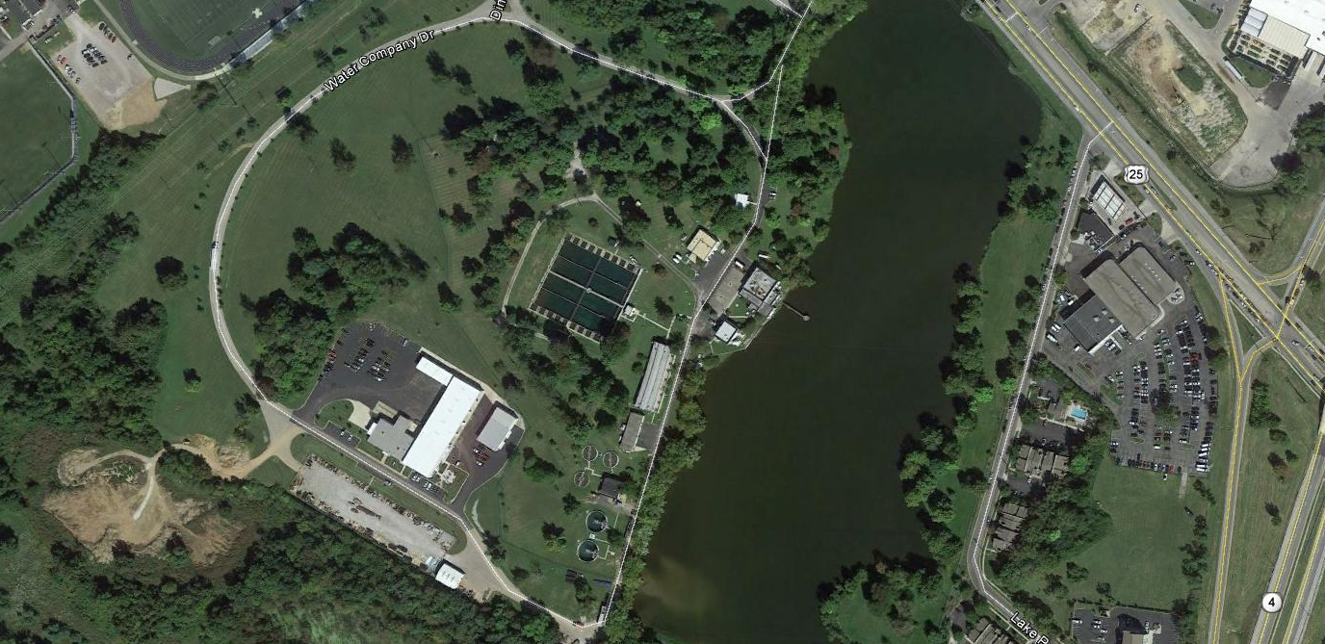
Asset Protection Zones
Group assets into asset protection zones
Zone 1
Zone 2

Slide 18
Benefits of Asset Protection Zones
Asset | AT1.5 | V1 | M1
Zone 1 | X | X | X
Zone 2 | X | X
Establish 2 asset protection zones
Reduce the number of T-A pairs from 25 to 5
Five-fold decrease in the number of T-A pairs to assess
Significant reduction in level of effort and cost
No loss of risk assessment value

Slide 19
Risk Calculations Level of Effort
Understand the sensitivity of components in risk equation
Adjust level of effort / emphasis
Recognize the difficultly in estimating terrorist threat likelihood
Threat likelihood accuracy ± 2 to 3 orders of magnitude
Proxy method game theory is labor intensive
Make practical decisions about level of effort
R = C * V * T
Where:
R = Risk
C = Consequence
V = Vulnerability
T = Threat Likelihood

Slide 20
Conclusions
Utilities should periodically update their VAs
J100 is the industry standard and yields many benefits
There are ways to strategically maximize the benefits of a J100 assessment while managing costs
Be careful not to just cut corners or it may negatively impact the outcome / product
Balance the investments a utility is willing to make versus the risk a utility is willing to accept
Understand the ramifications of the decisions you make
Begin with the end in mind

Slide 21


Questions?
Perry Gayle, PhD, PE, LEED AP perry.gayle@aecom.com (919) 461-1295
Heidi Gilmore, PE heidi.gilmore@aecom.com

